Slide 1
Chapter 6: Network Layer
Introduction to Networks v5.1

Slide 2
Chapter Outline
6.0 Introduction
6.1 Network Layer Protocols
6.2 Routing
6.3 Routers
6.4 Configure a Cisco Router
6.5 Summary

Slide 3
Section 6.1: Network Layer Protocols
Upon completion of this section, you should be able to:
Describe the purpose of the network layer in data communication.
Explain why the IPv4 protocol requires other layers to provide reliability. (To include: media independent, unreliable, and connectionless.)
Explain the role of the major header fields in the IPv4 packet.
Explain the role of the major header fields in the IPv6 packet.

Slide 4
Topic 6.1.1: Network Layer in Communication

Slide 5
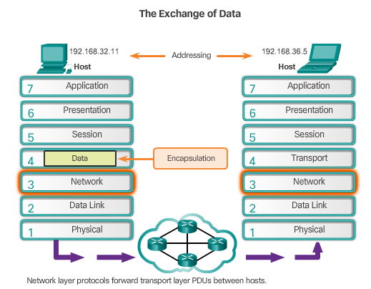
The Network Layer
End to End Transport processes
Addressing end devices
Encapsulation
Routing
De-encapsulating
Notes:
6.1.1.1 The Network Layer

Slide 6
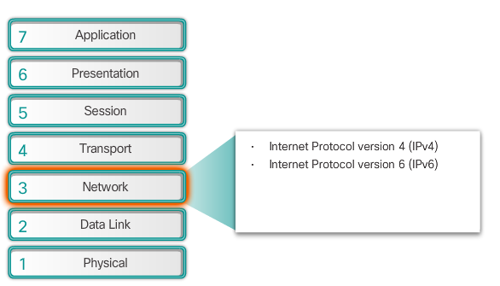
Network Layer Protocols
Notes:
6.1.1.2 Network Layer Protocols

Slide 7
Topic 6.1.2: Characteristics of the IP Protocol

Slide 8
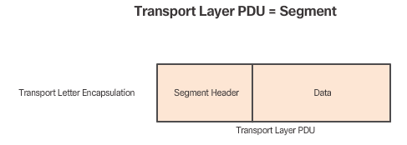
Encapsulating IP
Notes:
6.1.2.1 Encapsulating IP

Slide 9
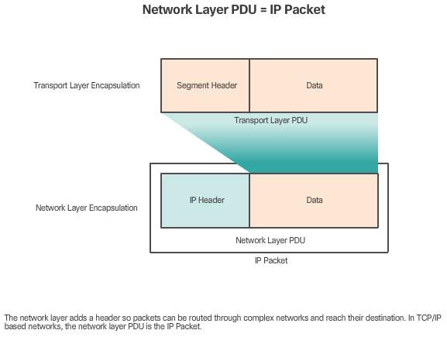
Encapsulating IP (cont.)
Notes:
6.1.2.1 Encapsulating IP

Slide 10
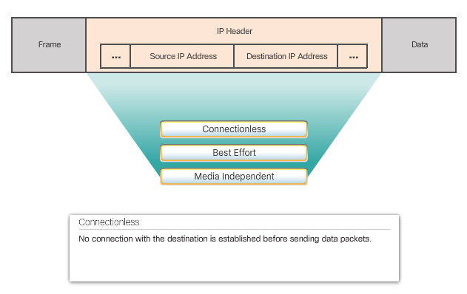
Characteristics of IP
Notes:
6.1.2.2 Characteristics of IP

Slide 11
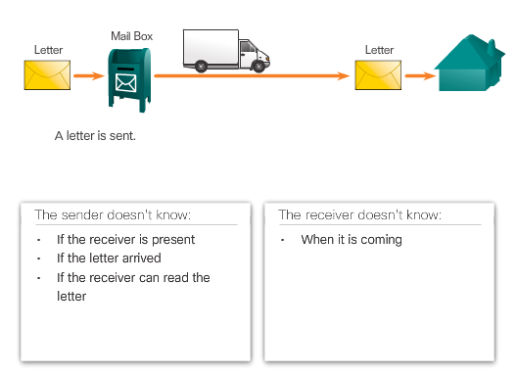
IP - Connectionless
Notes:
6.1.2.3 IP Connectionless

Slide 12
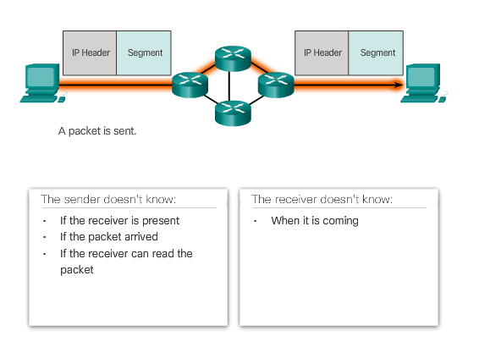
IP – Connectionless (cont.)
Notes:
6.1.2.3 IP Connectionless

Slide 13
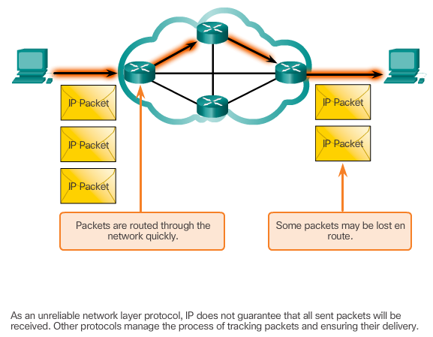
IP – Best Effort Delivery
Notes:
6.1.2.4 IP Best Effort Delivery

Slide 14
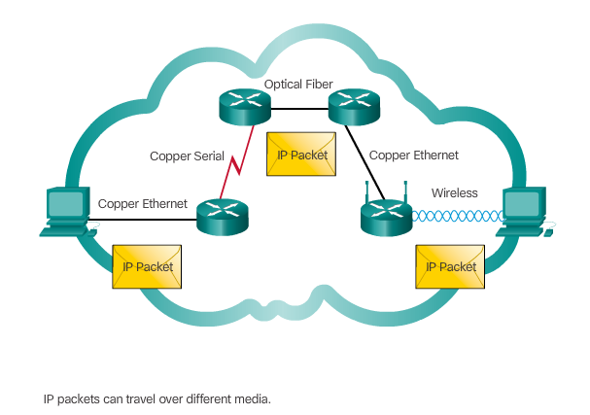
IP – Media Independent
Notes:
6.1.2.5 IP Media Independent
6.1.2.6 Activity – IP Characteristics

Slide 15
Topic 6.1.3: IPv4 Packet
Notes:
6.1.3 IPv4 Packet

Slide 16
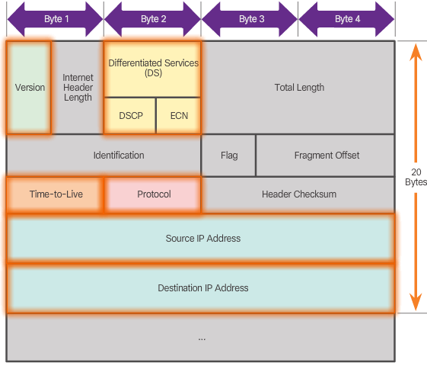
IPv4 Packet Header
Version = 0100
DS = Packet Priority
TTL = Limits life of Packet
Protocol = Upper layer protocol such as TCP
Source IP Address = source of packet
Destination IP Address = destination of packet
Notes:
6.1.3.1 IPv4 Packet Header
6.1.3.2 Video Demonstration - Sample IPv4 Headers in Wireshark
6.1.3.3 Activity – IPv4 Header Fields

Slide 17
Topic 6.1.4: IPv6 Packet
Notes:
6.1.4 IPv6 Packet

Slide 18

Limitations of IPv4
IP address depletion
Internet routing table expansion
Lack of end-to-end connectivity
Notes:
6.1.4.1 Limitations of IPv4

Slide 19
Introducing IPv6
Increased address space
Improved packet handling
Eliminates the need for NAT
4 billion IPv4 addresses
4,000,000,000
340 undecillion IPv6 addresses
340,000,000,000,000,000,000,000,000,000,000,000,000
vs.
Notes:
6.1.4.2 Introducing IPv6

Slide 20
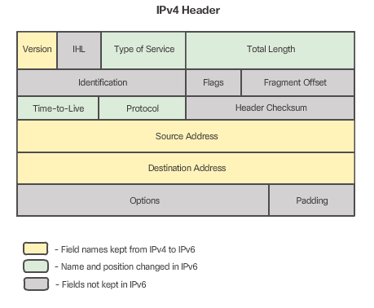
Encapsulating IPv6
IPv6 has a simplified header
Notes:
6.1.4.3 Encapsulation IPv6

Slide 21
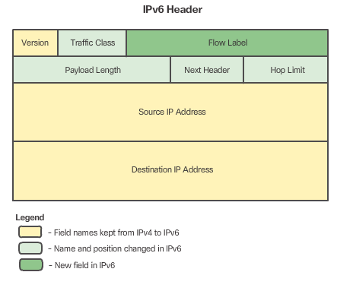
Encapsulating IPv6 (cont.)
IPv6 has a simplified header
Notes:
6.1.4.3 Encapsulation IPv6

Slide 22
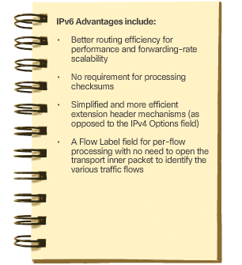
Encapsulating IPv6 (cont.)
Notes:
6.1.4.3 Encapsulation IPv6

Slide 23
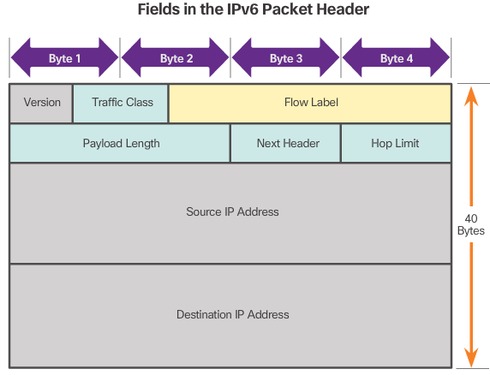
IPv6 Packet Header
Version = 0110
Traffic Class = Priority
Flow Label = same flow will receive same handling
Payload Length = same as total length
Next Header = Layer 4 Protocol
Hop Limit = Replaces TTL field
Notes:
6.1.4.4 IPv6 Packet Header
6.1.4.5 Video Demonstration - Sample IPv6 Headers and Wireshark
6.1.4.6 Activity - IPv6 Header Fields

Slide 24
Section 6.2: Routing
Upon completion of this section, you should be able to:
Explain how a host device uses routing tables to direct packets to itself, a local destination, or a default gateway.
Compare a host routing table to a routing table in a router.
Notes:
6.2 Routing

Slide 25
Topic 6.2.1: How a Host Routes
Notes:
6.2.1 How a Host Routes

Slide 26
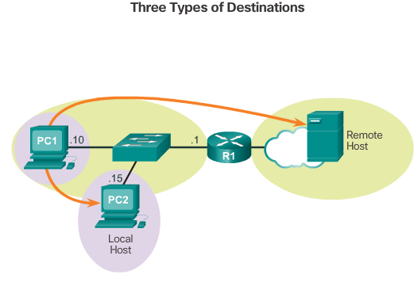
Host Forwarding Decision
Itself
Local Host
Remote Host
Notes:
6.2.1.1 Host Forwarding Decision

Slide 27
Default Gateway
Routes traffic to other networks
Has a local IP address in the same address range as other hosts on the network
Can take data in and forward data out
Notes:
6.2.1.2 Default Gateway

Slide 28
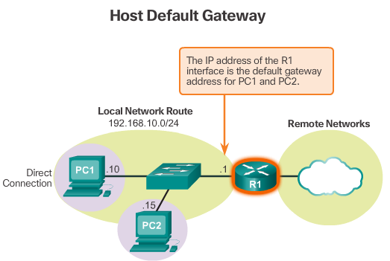
Using the Default Gateway
Notes:
6.2.1.3 Using the Default Gateway

Slide 29
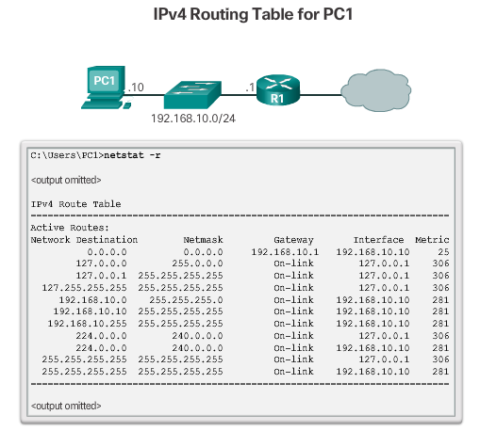
Host Routing Tables
Notes:
6.2.1.4 Host Routing Tables

Slide 30
Topic 6.2.2: Router Routing Tables
Notes:
6.2.2 Router Routing Tables

Slide 31
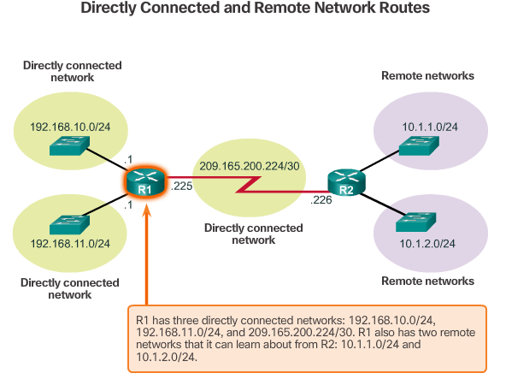
Router Packet Forwarding Decision
Notes:
6.2.2.1 Router Packet Forwarding Decision

Slide 32
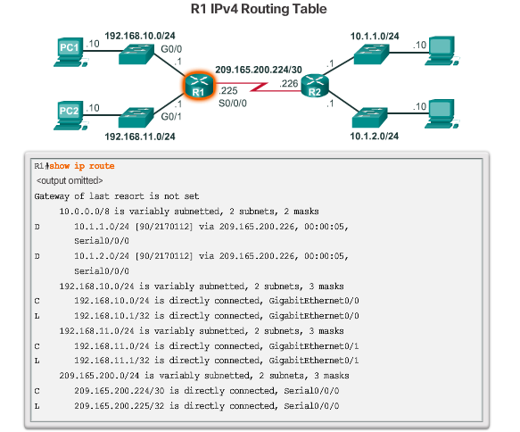
IPv4 Router Routing Table
Notes:
6.2.2.2 IPv4 Router Routing Table
6.2.2.3 Video Demonstration – Introducing the IPv4 Routing Table

Slide 33
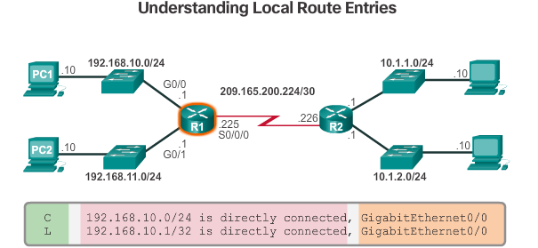
Directly Connected Routing Table Entries
Route source – Identifies how the network was learned by the router.
Destination network – Identifies the destination network and how it was learned.
Outgoing interface – Identifies the exit interface to use to forward a packet toward the final destination.
Notes:
6.2.2.4 Directly Connected Routing Table Entries

Slide 34
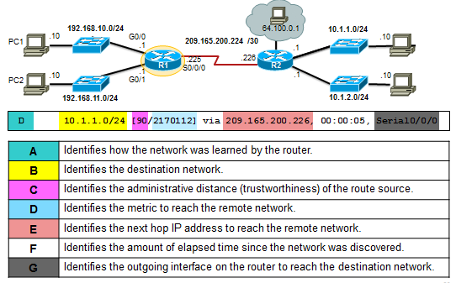
Remote Network Routing Table Entries
Notes:
6.2.2.5 Remote Network Routing Table Entries

Slide 35
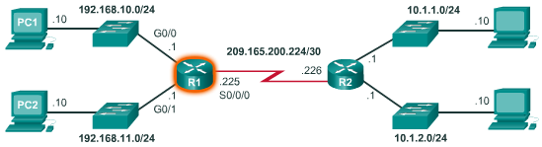
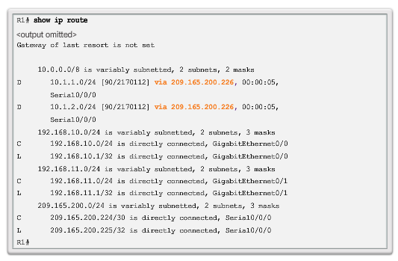
Next-Hop Address
Notes:
6.2.2.6 Next-Hop Address
6.2.2.7 Video Demonstration – Explaining the IPv4 Routing Table
6.2.2.8 Activity – Identify Elements of a Router Routing Table Entry

Slide 36
Section 6.3: Routers
Upon completion of this section, you should be able to:
Describe the common components and interfaces of a router.
Describe the boot-up process of a Cisco IOS router.
Notes:
6.3 Routers

Slide 37
Topic 6.3.1: Anatomy of a Router
Notes:
6.3.1 Anatomy of a Router

Slide 38
A Router is a Computer/Router CPU and OS
Routers require:
Central processing units (CPUs)
Operating systems (OSs)
Memory consisting of:
Random-access memory (RAM)
Read-only memory (ROM)
Nonvolatile random-access memory (NVRAM)
Flash
The Cisco Internetwork Operating System (IOS) is the system software used for most Cisco devices regardless of the size and type of the device.

Slide 39
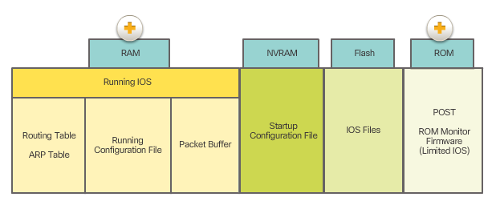
Router Memory
RAM uses the following applications and processes:
IOS and running-config
Routing table
ARP cache
Packet buffering
ROM stores the following:
Bootup information that provides the startup instructions
Power-on self-test (POST) that tests all the hardware components
Limited IOS to provide a backup version of the IOS.
Notes:
6.3.1.3 Router Memory

Slide 40
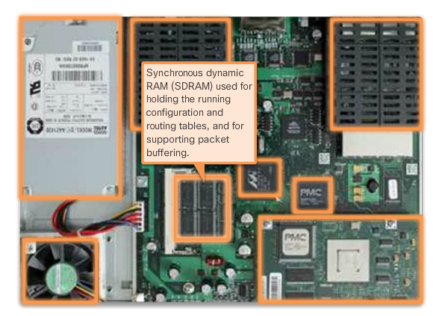
Inside of a Router
Notes:
6.3.1.4 Inside of a Router

Slide 41
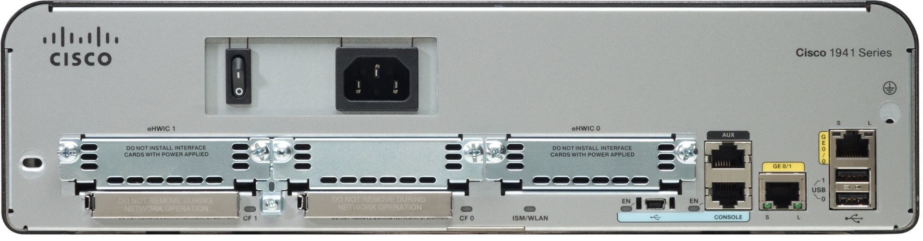
Connect to a Router
Double-wide eHWIC slots
eHWIC 0
AUX
port
LAN
interfaces
Console RJ45
USB
Ports
Two 4 GB flash card slots
Console
USB Type B
Notes:
6.3.1.5 Connect to a Router

Slide 42
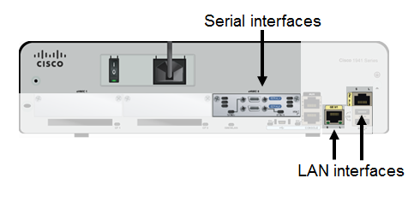
LAN and WAN Interfaces
Notes:
6.3.1.6 LAN and WAN Interfaces
6.3.1.7 Activity – Identify Router Components
6.3.1.8 PT – Exploring Internetworking Devices

Slide 43
Topic 6.3.2: Router Boot-up
Notes:
6.3.2 Router Boot-up

Slide 44
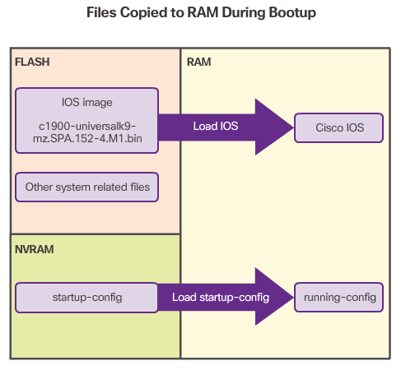
Bootset Files
Notes:
6.3.2.1 Bootset Files

Slide 45
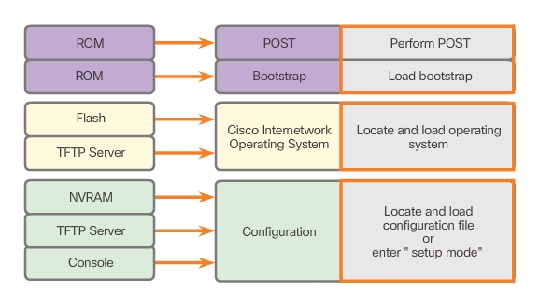
Router Bootup Process
Notes:
6.3.2.2 Router Bootup Process
6.3.2.3 Video Demonstration – Router Bootup Process

Slide 46
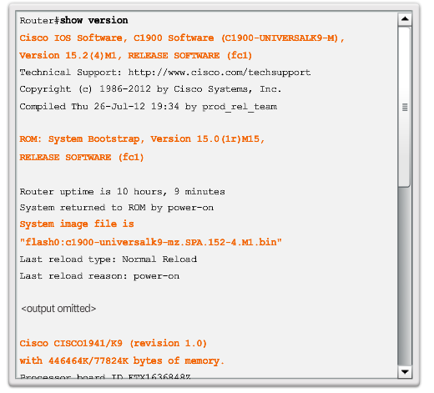
Show version output
Notes:
6.3.2.4 Show version output

Slide 47
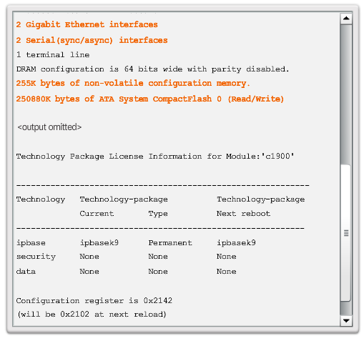
Show version output (cont.)
Notes:
6.3.2.4 Show version output
6.3.2.5 Video Demonstration – The show version command
6.3.2.6 Activity – The Router Boot Process
6.3.2.7 Lab – Exploring Router Physical Characteristics

Slide 48
Section 6.4: Configure a Cisco Router
Upon completion of this section, you should be able to:
Configure initial settings on a Cisco IOS router.
Configure two active interfaces on a Cisco IOS router.
Configure devices to use the default gateway.

Slide 49
Topic 6.4.1: Configure Initial Settings
Notes:
6.4.1 Configure Initial Settings

Slide 50
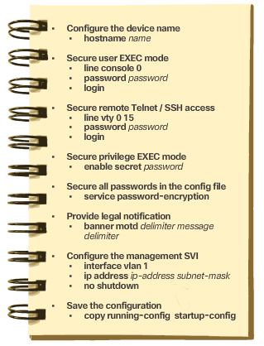
Basic Switch Configuration Steps
Notes:
6.4.1.1 Basic Switch Configuration Steps

Slide 51
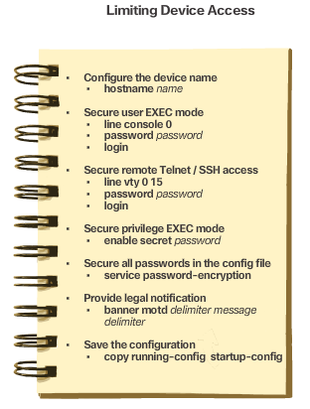
Basic Router Configuration Steps
Notes:
6.4.1.2 Basic Router Configuration Steps
6.4.1.3 Packet Tracer – Configure Initial Router Settings

Slide 52
Topic 6.4.2: Configure Interfaces

Slide 53
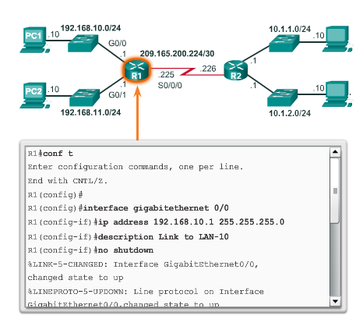
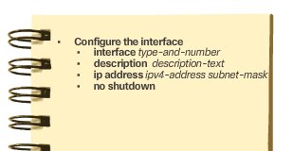
Configure Router Interfaces
Notes:
6.4.2.1 Configure Router Interfaces

Slide 54
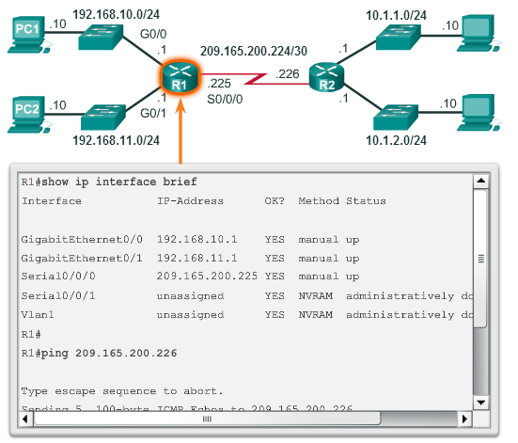
Verify Interface Configuration
show ip route - Displays the contents of the IPv4 routing table stored in RAM.
show interfaces -Displays statistics for all interfaces on the device.
show ip interface -Displays the IPv4 statistics for all interfaces on a router.
Notes:
6.4.2.2 Verify Interface Configuration

Slide 55
Topic 6.4.3: Configure the Default Gateway
Notes:
6.4.3 Configure the Default Gateway

Slide 56
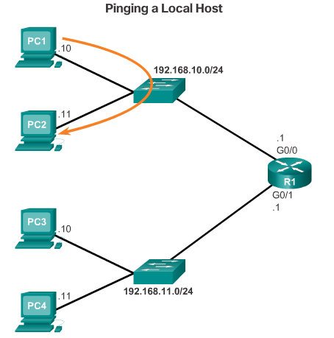
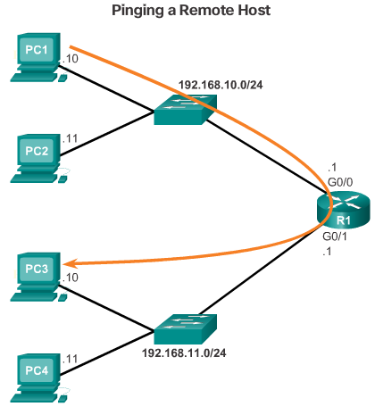
Default Gateway for a Host
Notes:
6.4.3.1 Default Gateway for a Host

Slide 57
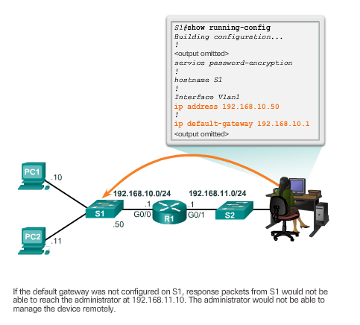
Default Gateway for a Switch
Notes:
6.4.3.2 Default Gateway for a Switch
6.4.3.3 PT – Connect a Router to a LAN
6.4.3.4 PT – Troubleshooting Default Gateway Issues

Slide 58
Section 6.5: Summary
Chapter Objectives:
Explain how network layer protocols and services support communications across data networks.
Explain how routers enable end-to-end connectivity in a small to medium-sized business network.
Explain how devices route traffic in a small to medium-sized business network.
Configure a router with basic configurations.
Notes:
6.5.1.1 Class Activity – Can you read this map?
6.5.1.2 Lab – Building a Switch and Router Network
6.5.1.3 PT – Skills Integration Challenge
6.5.1.4 Summary

